Slide 1
Possible Solution for Set-Cover problem

Slide 2
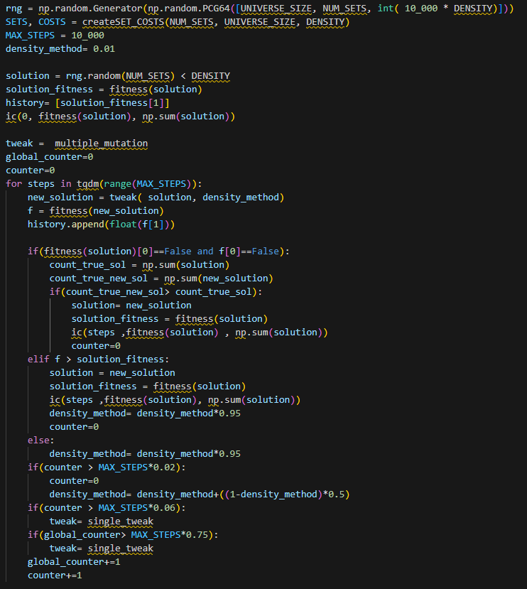
How works the algorithm?
1 Find valid solution
2 Improve with different jump
3 Manage local points
4 Apply a response

Slide 3
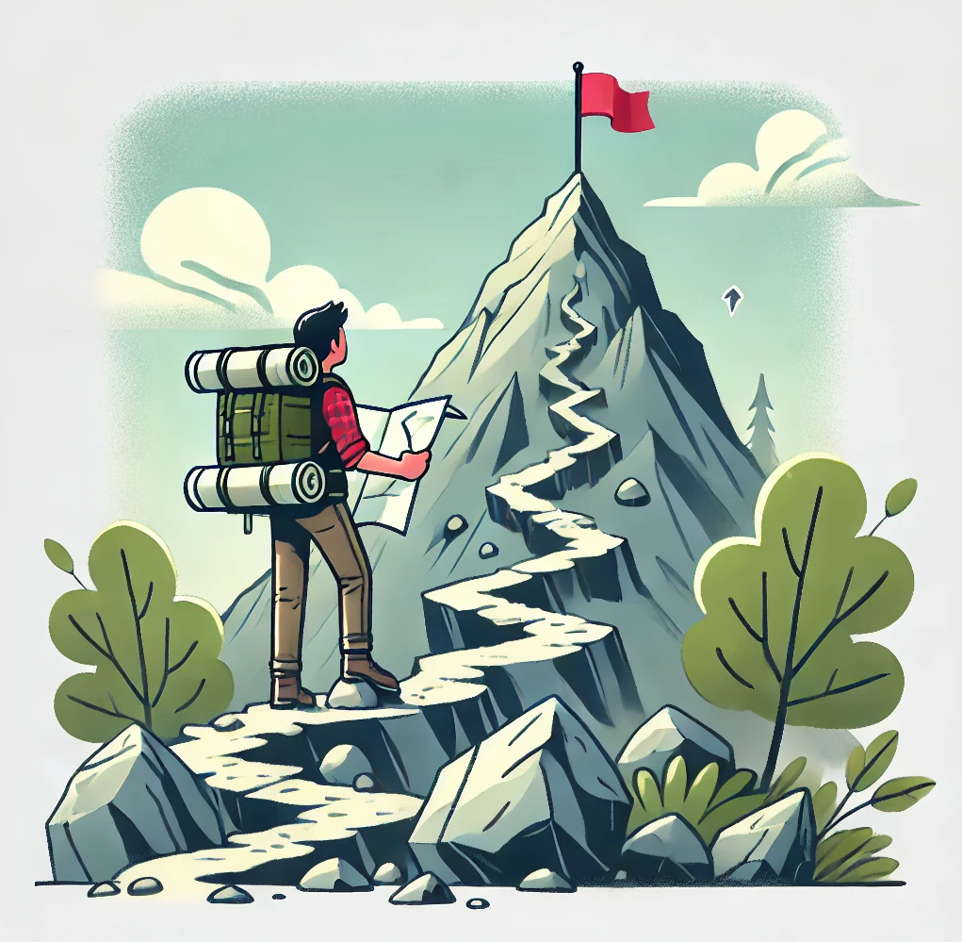
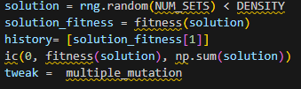
- A hiker standing at the base of the mountain, with a flag at
the top representing the goal. The hiker looks at the map and realizes that their starting path can be valid or invalid.
- The algorithm generates the first solution, throw the fitness method, «virtually» we have the starting point.

Slide 4

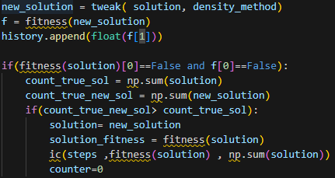
- The hiker is evaluating different paths, comparing
the clear and blocked ones
- Beyond tweak method, the algorithm uses the multi-mutation and
accept as input a floating point that defines the «strenght» of
exploration phase
- Important: the algorithm try to minimize the cost function using a valid solution, the two conditions must coexist.
The algorithm prioritize for the first moment a solution that is at least valid.
The hypothesis is :” more True we have and more probable the solution is valid

Slide 5

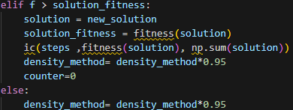
- Where the hiker is making progress up the mountain after choosing a better path.
The algorithm has already found a valid solution, it finds new solution around.
-The algorithm in this phase has 2 goals, replace the new solution if is better and counts for how many times doesn’t find any solution
-At every step the algorithm reduces of the 5% the variable density method to have a lower exploration phase

Slide 6
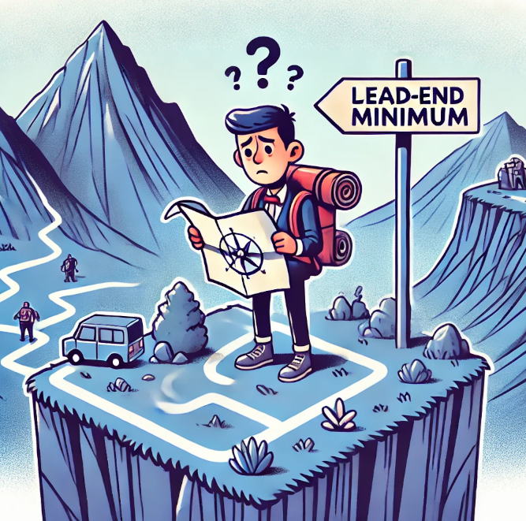
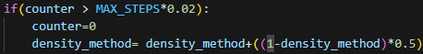
- The hiker stuck on a plateau, reevaluating their path.
The algorithm is in minimum, and if for a certain number of iterations is in the same point, then it explores new solution
X(i +1) = X(i) + ( ( 1-X(i)) *0.5))
The algorithm increases the exploration value, using the part in which we are not exploring new solution ( 1-X(i)) and add half of this percentage. In this way the algorithm force the value in the range [0,1]

Slide 7

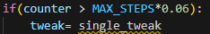
- The hiker using climbing gear to overcome a difficult section of the mountain
- If the algorithm doesn’t see any improvement, the try to change complitely the algorithm, using small steps
- The algorithm don’t need anymore the variable density_method to jump

Slide 8
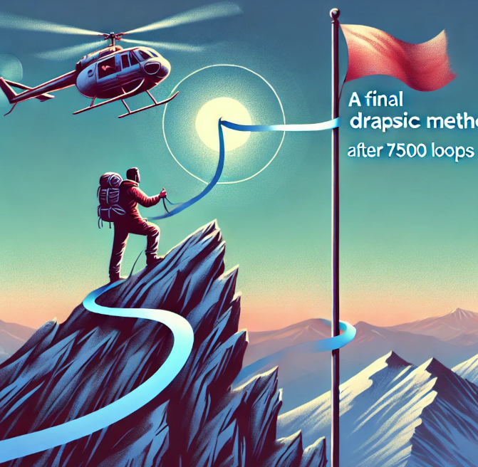
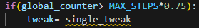
-The hiker using a drastic method to reach the summit after many attempts
-The last part of the simulation the algorithm say: “ oh , I optimized enough my solution, I want walk slowly to have my last improvement”
Important: Looks like, the same operation of the previous step, but the algorithm in the previous step cann’t fall in that statement because the exploration phase can produce acceptable solutions

Slide 9
Again recap of the algorithm

Slide 10
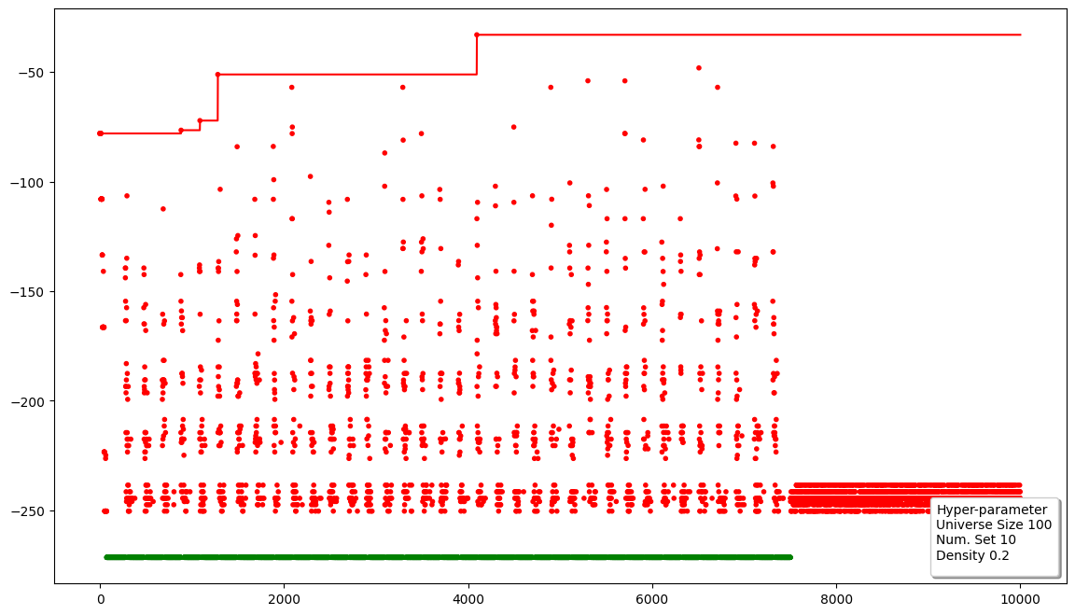
Results

Slide 11
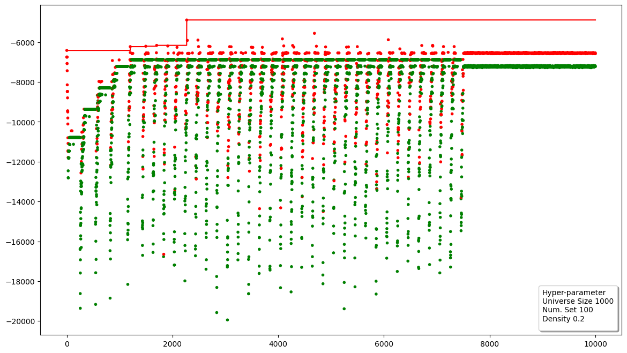

Slide 12
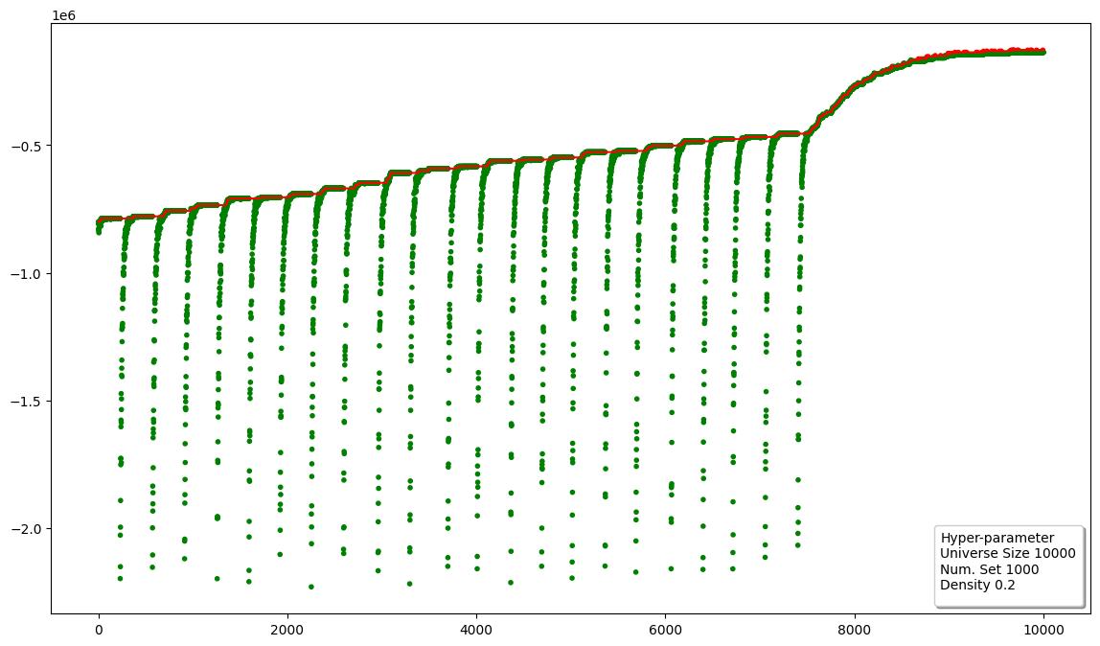

Slide 13
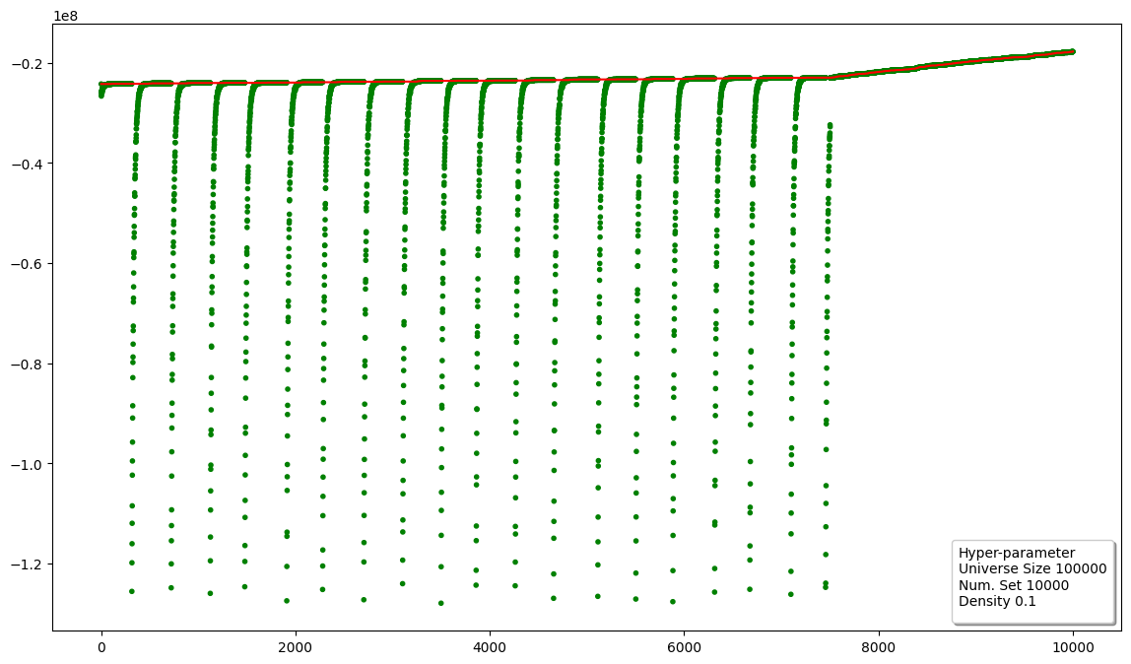

Slide 14
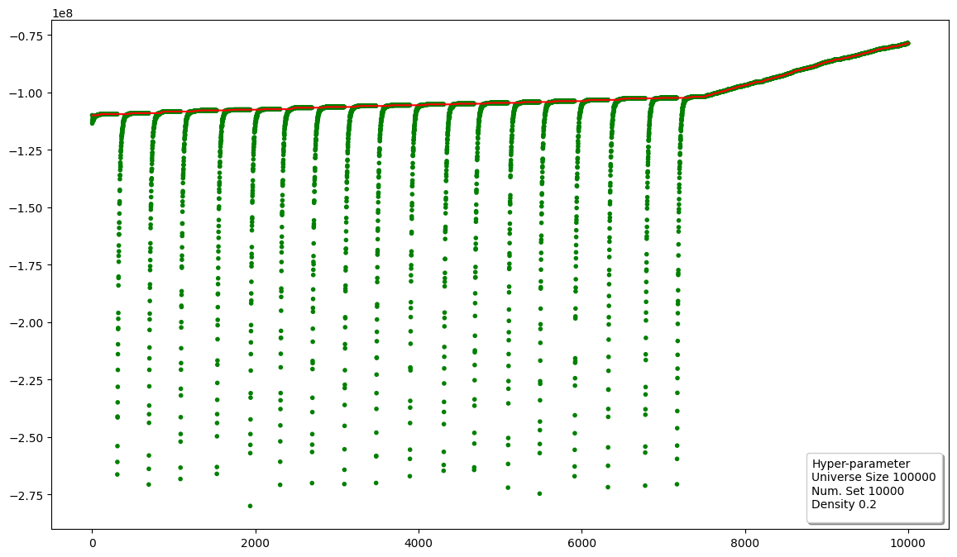

Slide 15


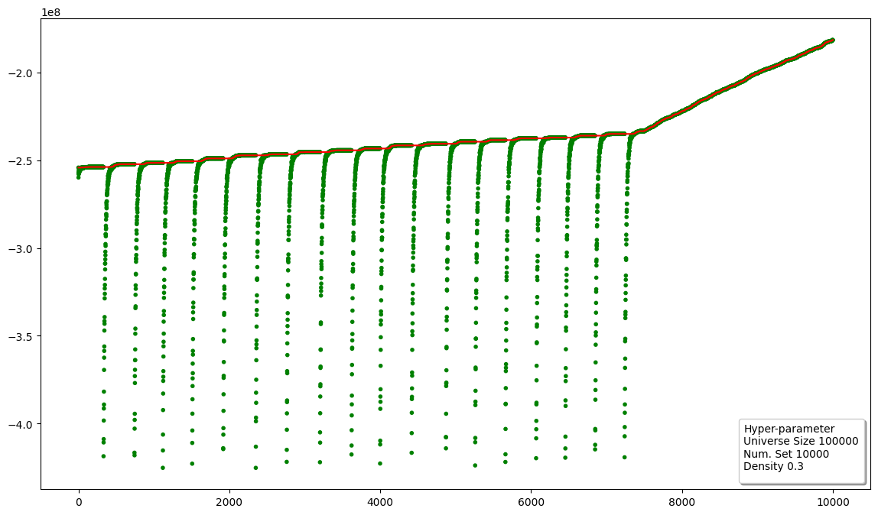

Notice the slope, if the starting density is higher,
is easier improve the solution.

